Slide 1
Digital Portfolio
STUDENT NAME: R LINGESH KUMAR
REGISTER NO AND NMID: 8EC950B440794198C29490C4346353
DEPARTMENT: COMPUTER APPLICATION
COLLEGE: PERI COLLEGE OF ARTS AND SICENCE/MADRAS UNIVERSITY

Slide 2
Digital Portfolio Welcome to my digital portfolio! This portfolio is a reflection of my journey as a web developer and my passion for creating meaningful and efficient web experiences. As a student, I am constantly exploring new technologies, enhancing my skills in Python, Data Structures and Algorithms, and web development. Through this portfolio, I aim to showcase not only my technical skills but also my creativity and problem-solving abilities.

Slide 3


AGENDA
Problem Statement
Project Overview
End Users
Tools and Technologies
Portfolio design and Layout
Features and Functionality
Results and Screenshots
Conclusion
Github Link
3/21/2024 Annual Review

Slide 4

PROBLEM STATEMENT
A digital portfolio allows you to showcase your skills and work in an interactive, visually appealing way. It's easy to share, always up-to-date, and serves as a personal brand statement, helping you stand out to potential employers or clients. It’s also a cost-effective, eco-friendly
alternative to traditional portfolios, and with features like SEO and analytics, it can help you gain more visibility and track engagement. Plus, it’s accessible anywhere, anytime—making it a valuable tool for modern professionals.

Slide 5

PROJECT OVERVIEW A project overview provides a concise summary of a project’s key goals, objectives, and outcomes. It highlights the scope, timeline, and technologies used, giving viewers a quick understanding of the project’s purpose and significance. This section typically includes the challenges faced, the solutions implemented, and any notable achievements or results. It serves as an introduction to the project, providing context before diving into the details or code.

Slide 6

WHO ARE THE END USERS? End users are the people who interact with and benefit from a product or service. In the case of a digital portfolio, the end users could include potential employers, clients, collaborators, fellow professionals, and students. These users visit your portfolio to assess your skills, explore your projects, or even connect for job opportunities, freelance work, or collaborations. Understanding their needs helps tailor your portfolio to provide the most value.

Slide 7

TOOLS AND TECHNIQUES
The project uses HTML5 for structure, CSS3 for styling with techniques like Flexbox and Grid for responsive layouts,and JavaScript for form validation and interactivity. It also includes smooth scrolling, hover effects, and amobile-friendly navigation menu for a seamless user experience across devices.

Slide 8
POTFOLIO DESIGN AND LAYOUT
The portfolio design is clean, modern, and user-friendly, with a focus on showcasing key information
in an organized manner. The layout uses flexible grids and responsive design to ensure it looks great on all devices.
A hero section introduces the user, followed by an About Me section, Projects showcase, and a Contact form.
The navigation bar is simple and intuitive, with smooth scrolling for easy section navigation, while hover effects and
transitions add interactive elements for a dynamic user experience.
8

Slide 9
FEATURES AND FUNCTIONALITY
The features and functionality of the digital portfolio include responsive design for mobile and desktop, smooth scrollingfor easy navigation, and an interactive hero section to introduce yourself. It showcases projects with hover effects, includes a contact form with validation, and links to social media profiles. The design also incorporates animations, SEO optimization, and a mobile-friendly navigation menu for seamless user experience across devices.

Slide 10
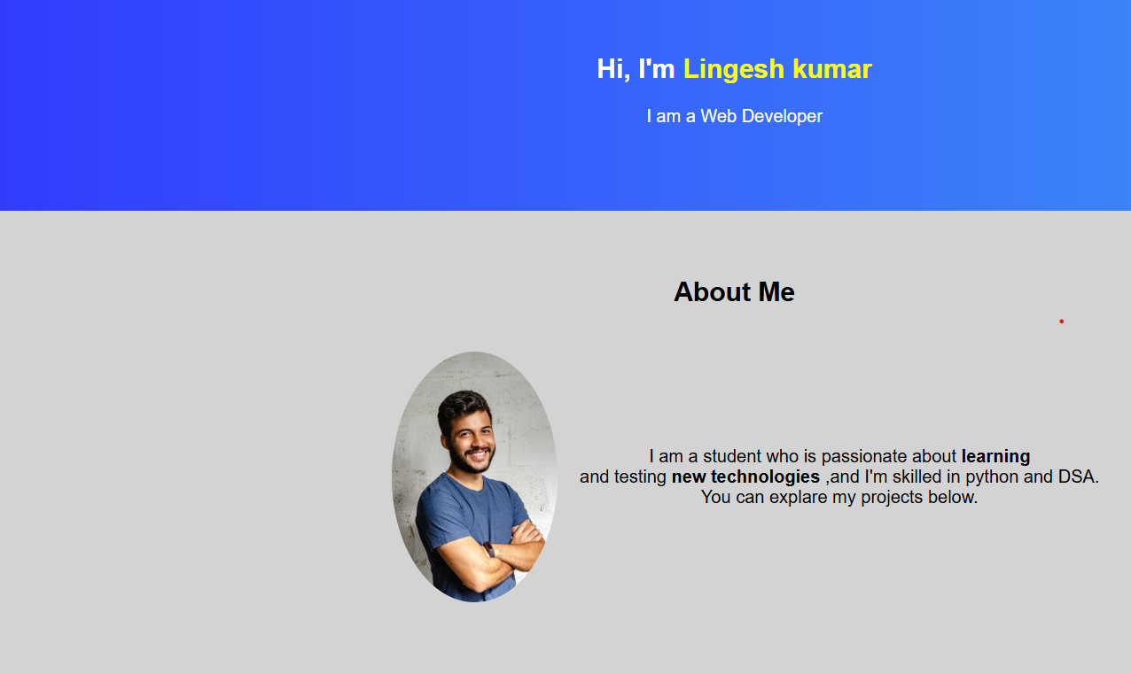
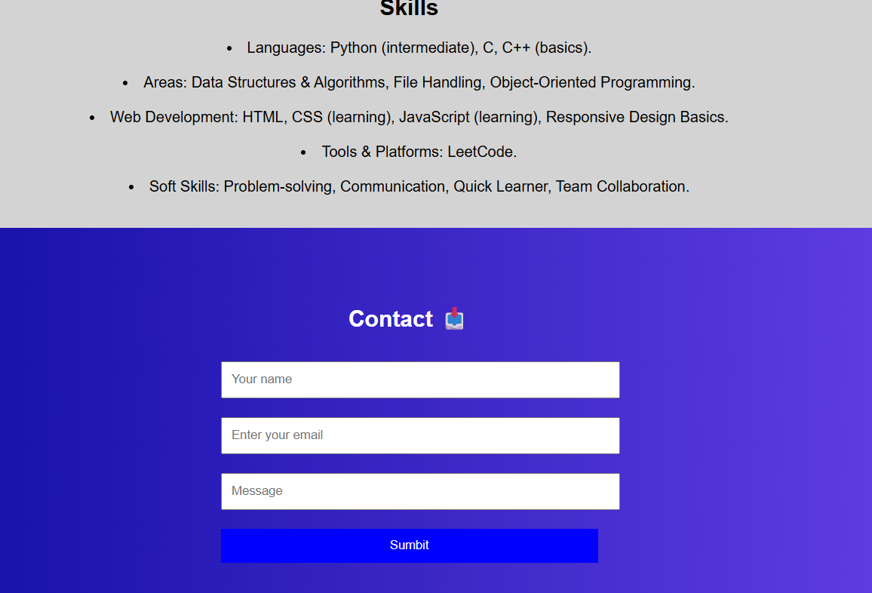

RESULTS AND SCREENSHOTS
3/21/2024 Annual Review
10

Slide 11
CONCLUSION
In conclusion, this digital portfolio effectively showcases my skills, projects, and achievements in a modern,
user-friendly format. With responsive design, smooth navigation, and interactive features, it provides an engaging
experience for visitors. This portfolio serves as a dynamic reflection of my growth as a web developer,
offering a comprehensive view of my work and capabilities to potential employers, clients, and collaborators.
11

